Slide 1
CS 4350: Fundamentals of Software Engineering CS 5500: Foundations of Software Engineering Lesson 6.2 Introduction to “React”
Jon Bell, John Boyland, Mitch Wand
Khoury College of Computer Sciences
© 2021 Jonathan Bell, John Boyland and Mitch Wand. Released under the CC BY-SA license

Slide 2
Topic for this Lesson
React/JS: Front-End Framework
Created by Facebook; released to open-source.
Describe architecture and big ideas.
https://reactjs.org/

Slide 3
Learning Objectives for this Lesson
By the end of this lesson, you should be able to:
Explain how component reuse simplifies application development;
Describe the three key ideas of the React framework.

Slide 4
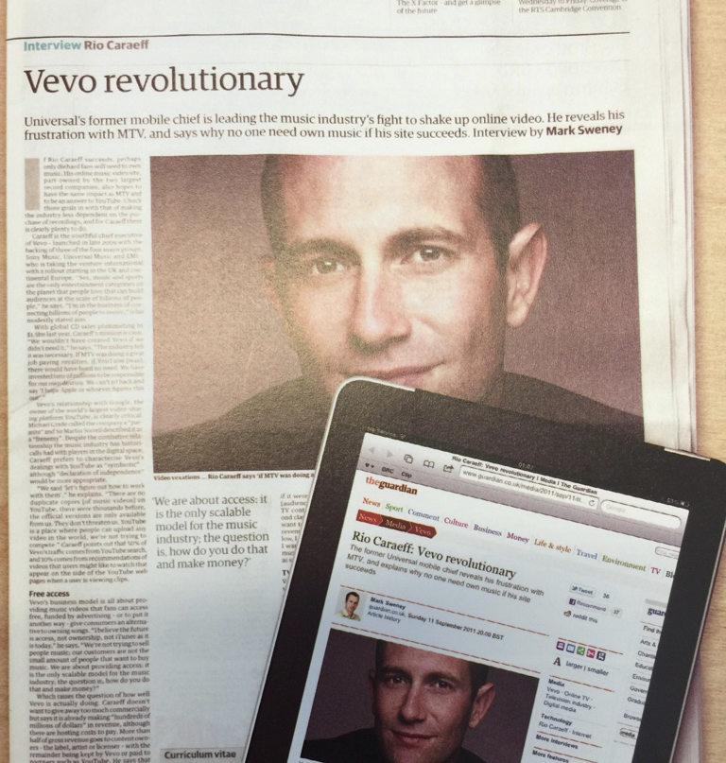
HTML: Markup Language of the Web
Language for describing structure of a document:
Denotes hierarchy of elements.
What might be elements in this document?

Slide 5
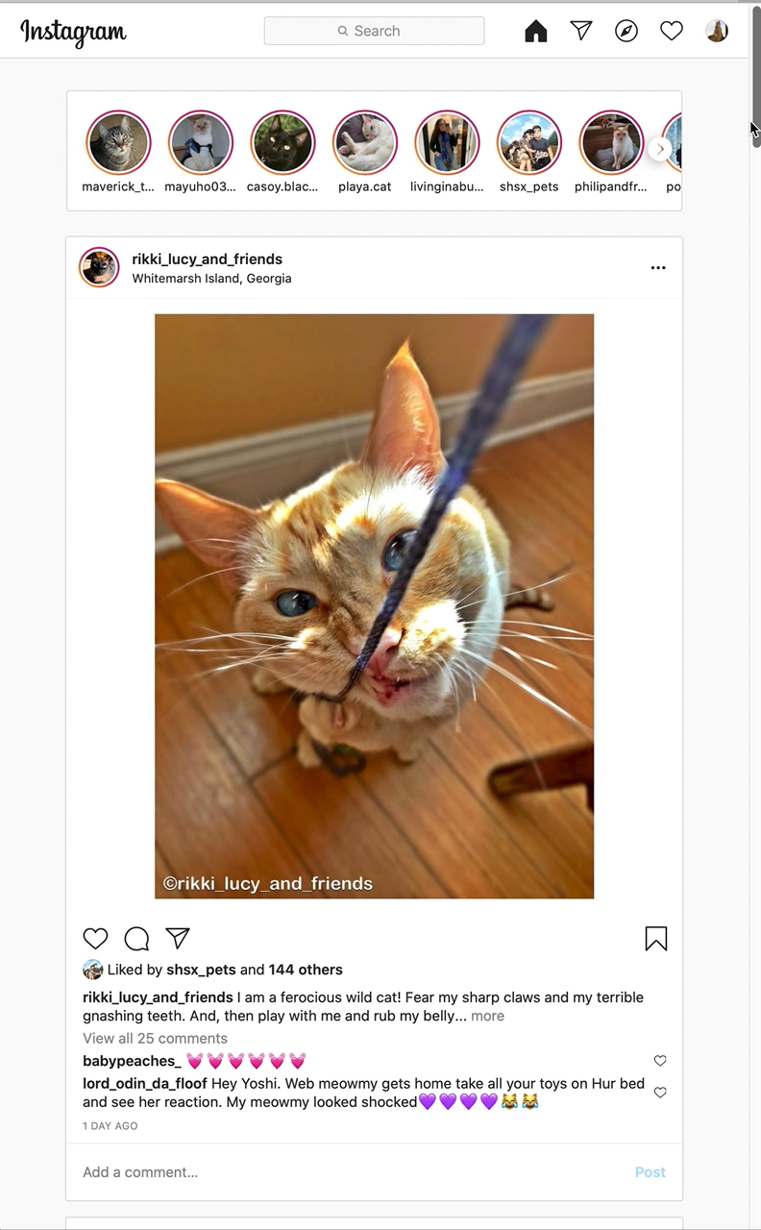
Rich Interactive Web Applications
Not just static HTML
Infinite scrolling of cat photos.
In video, more photos are “loaded” when we get near the bottom.

Slide 6

Widgets in Web UIs
Each widget has both visual presentation & logic
e.g., clicking on like button executes logic related to the containing widget
Logic and presentation of individual widgets are strongly related,
Widgets often occur more than once
e.g., comment/like widgets
Changes to data should cause changes to widget
e.g., new images, new comments should show up in real time

Slide 7
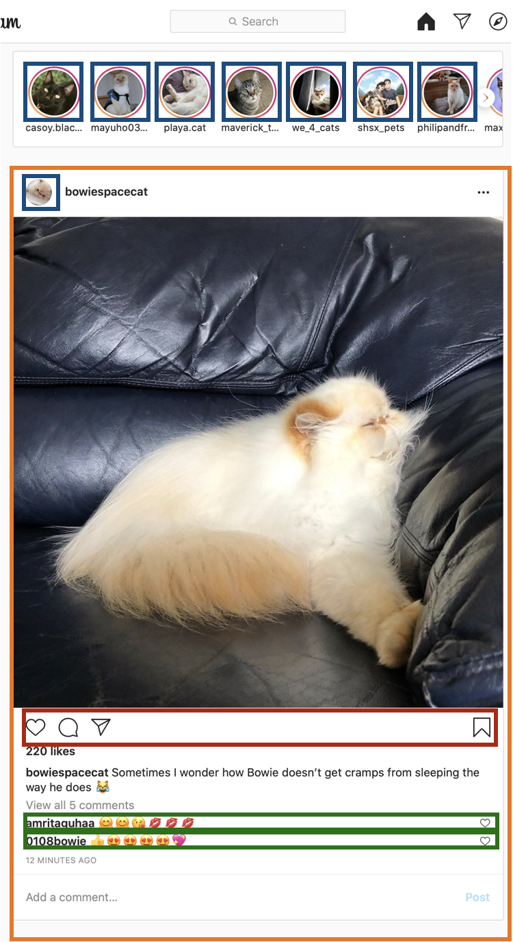
Key Idea: Components
Organize related logic and presentation into a single unit
Includes necessary state and the logic for updating this state
Includes presentation for rendering this state into HTML
Synchronizes state and visual presentation
Whenever state changes, HTML should be rendered again

Slide 8

“Like” Button Component
What does it keep track of?
Is it liked or not?
What post is it associated with?
What logic does the button have?
When changing “like” status, send update to server.
How does the button look?
Filled in if liked, hollow if not.
Problem: how do we automatically update the button to look filled in when it’s liked?

Slide 9
Design Architecture Possibilities
PHP
Java Applet
CGI Perl
React
Code embedded in HTML
HTML embedded in Code
Server
Client

Slide 10
Embedding
Code in HTML
HTML in Code
<p>Counting to three:</p> <% for (int i=1; i<4; i++) { %> <p>This number is <%= i %>.</p> <% } %> <p>OK.</p>
Convenient, but …
Code infeasible to statically check (it is broken up in different HTML comments).
return “<p> Items:” + is + “\n<b>Total: “ + total + “</b></p>\n”;
Code has primacy (and can be checked).
Creation of HTML is error-prone.

Slide 11
Where Does Code Run?
On Server (back end)
On Client (front end)
If it runs on the server, we have full control of the HTML generated and can (in principle) use private state.
But we have no control on the rendering process for the HTML:
Incrementality is on client.
And have to push changes to client.
If on the client, the code runs in a variety of (perhaps adversarial) contexts,
But we can control incrementality.

Slide 12

React: Front End Framework for Components
Key concepts:
Embed HTML in JavaScript;
Track application “state”;
Automatically and efficiently re-render page in browser based on changes to state.
React developed by Facebook:
Also used in airbnb, Uber, Pinterest, Netflix, Twitter and 8855 more

Slide 13
Embed HTML in JavaScript/TypeScript
return <div>Hello {person.name}</div>;
Can create HTML by using HTML syntax:
Inside braces { … } we can put arbitrary code, the result of which will be converted to a string in the HTML.
All open tags must be closed (as in XML).
Can create components with Capitalized tags:
return <Card> <p>Adriel</p> </Card>;
Here “Card” is a user-defined component.
Syntax is transpiled back to JavaScript (as is TS).

Slide 14
Example Component Definition
import React from ‘react’;
export interface GreetOpts {
name : string;
}
export const Greet = (opts : GreetOpts) => {
return <p> Hello {opts.name}, nice to meet you! </p>;
}
This code defines how to render
<Greet name=“Chris”/>
Each component needs own file.
If it has properties, export an interface defining them.
Component defined as a function taking properties and returning HTML.
Properties are immutable.
Components can also be implemented with classes.

Slide 15
State vs. Properties
State changes to reflect the current state of the component.
Can (and should) change based on the current data of component.
A ”like” button keeps track of:
Is it liked or not (state)
What post this is associated with (property)
If component is a function, how do we represent the state?

Slide 16
Hooks Give Access to State
Replace the body of the function with:
const [formal, setFormal] = useState(true);
if (formal) {
return <p>Hello, {opts.name}, how do you do?</p>;
} else {
return <p>Hi, {opts.name}, what’s up?</p>;
}
The “useState” function …
… declares a state variable, ...
... with an initial value.
The “useState” function returns an array of two values:
The current value;
A setter taking a new value.
Each time you call it, you get a new state variable.
Only call at top level of function!
Warning: The setter is currently unused!

Slide 17
Reacting to change
How does the greeting update?
If the setter is called, the function is invoked again by framework.
Then the framework diffs output of render with previous call to render, updating only that part of DOM (Document Object Model) that changed.
The last step, “reconciliation,” is a key idea of React.

Slide 18
Reconciliation: Efficient Update
React updates the DOM (HTML) each time the components change.
Basically, change is based on order of components
Second child of Card is destroyed.
First child of Card has text mutated.
Before:
After:
<Card>
<p>Paragraph 1</p>
<p>Paragraph 2</p>
</Card>
<Card>
<p>Paragraph 2</p>
</Card>
Reconciliation is much more complicated.

Slide 19
Review: Learning Objectives for this Lesson
You should now be able to:
Explain how component reuse simplifies application development;
Describe the three key ideas of the React framework.

Slide 20
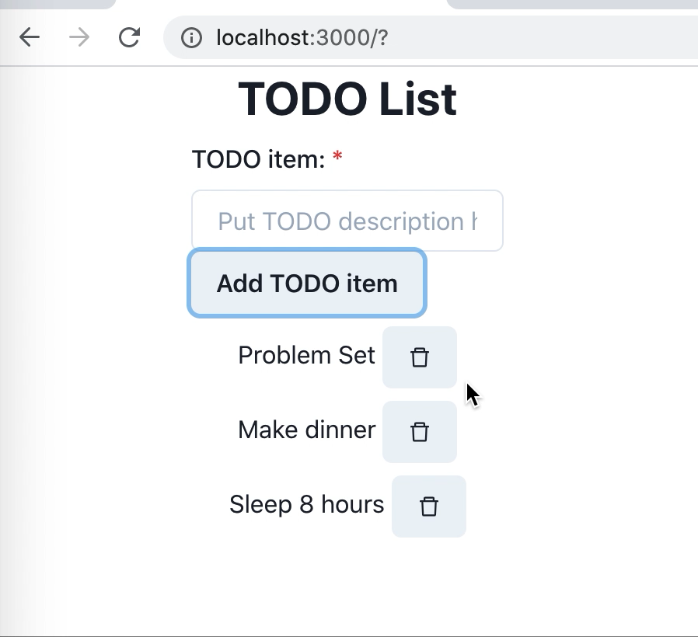
Looking ahead
The next part of Lesson 6 includes a tutorial building a simple TODO app in React.

